Slide 1
Unity务实精讲
韩红雷
中国传媒大学

Slide 2
目录
光照、阴影及全局光照
摄像机及遮挡剔除优化
材质、着色器及环境映射
粒子系统
物理引擎
Mecanim动画系统
寻路
联网
创作中遇到的问题讨论

Slide 3
目录
光照、阴影及全局光照
摄像机及遮挡剔除优化
材质、着色器及环境映射
粒子系统
物理引擎
Mecanim动画系统
寻路
联网
创作中遇到的问题讨论

Slide 4
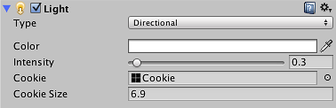
Uses of Cookies

Slide 5
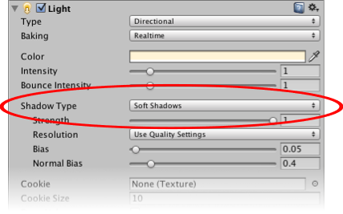
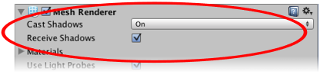
Shadows

Slide 6
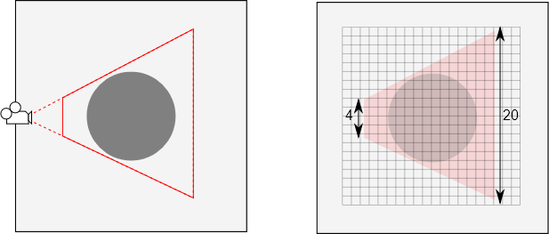
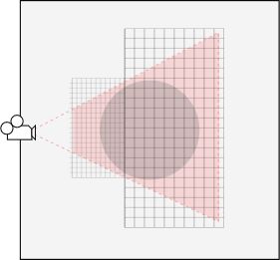
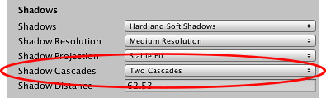
Shadow Cascades

Slide 7
全局光照
Both Baked GI and Precomputed Realtime GI have the limitation that only static objects can be included in the bake/precomputation - so moving objects cannot bounce light onto other objects and vice versa
However they can still pick up bounce light from static objects using Light Probes
So for example a red ball that rolls up next to a white wall would not bleed its color onto the wall, but a white ball next to a red wall could pick up a red color bleed from the wall via the light probes.

Slide 8
目录
光照、阴影及全局光照
摄像机及遮挡剔除优化
材质、着色器及环境映射
粒子系统
物理引擎
Mecanim动画系统
寻路
联网
创作中遇到的问题讨论

Slide 9
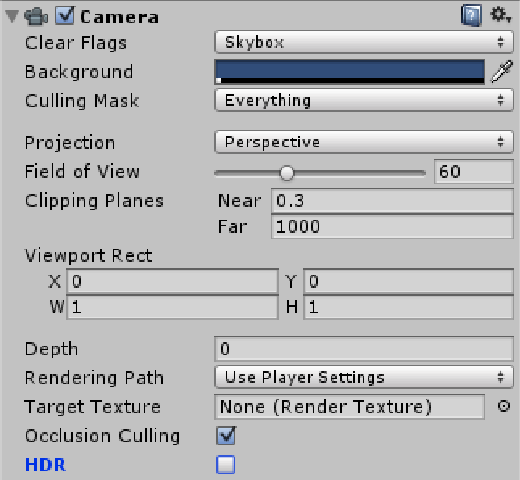
使用多个摄像机

Slide 10
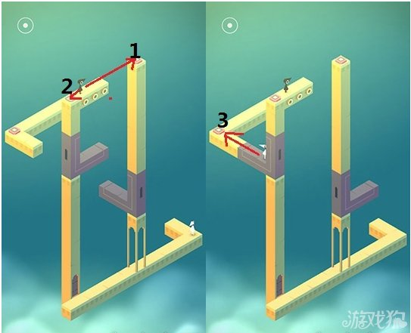
Perspective and orthographic cameras

Slide 11
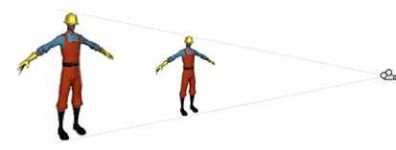
Dolly Zoom (AKA the “Trombone” Effect)

Slide 12
Raycasting
鼠标点选
public Camera camera;
void Start(){
RaycastHit hit;
Ray ray = camera.ScreenPointToRay(Input.mousePosition);
if (Physics.Raycast(ray, out hit)) {
Transform objectHit = hit.transform;
// Do something with the object that was hit by the raycast.
}
}

Slide 13
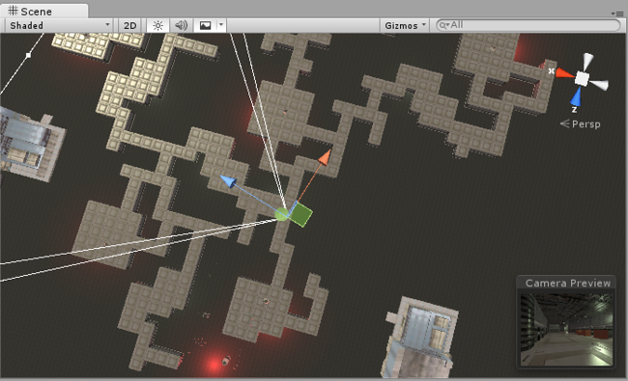
Occlusion Culling

Slide 14
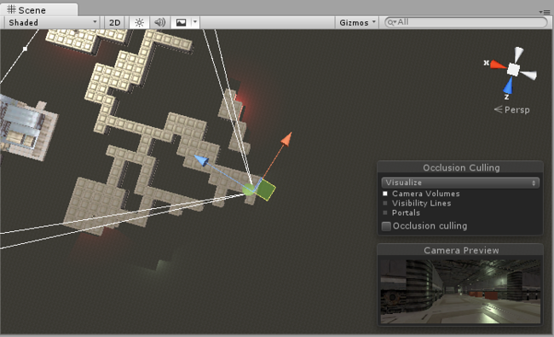

Slide 15
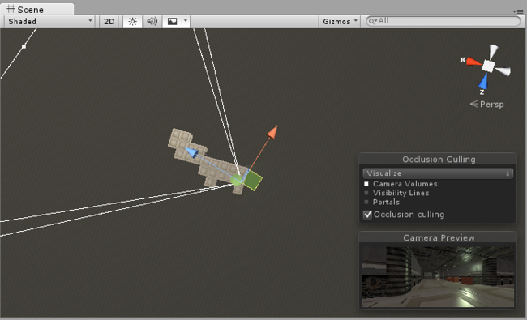

Slide 16
目录
光照、阴影及全局光照
摄像机及遮挡剔除优化
材质、着色器及环境映射
粒子系统
物理引擎
Mecanim动画系统
寻路
联网
创作中遇到的问题讨论

Slide 17
Materials And Shaders
Materials are definitions of how a surface should be rendered, including references to textures used, tiling information, colour tints and more. The available options for a material depend on which shader the material is using.
Shaders are small scripts that contain the mathematical calculations and algorithms for calculating the colour of each pixel rendered, based on the lighting input and the Material configuration.

Slide 18
Built-in Shaders
FX: Lighting and glass effects.
GUI and UI: For user interface graphics.
Mobile: Simplified high-performance shader for mobile devices.
Nature: For trees and terrain.
Particles: Particle system effects.
Skybox: For rendering background environments behind all geometry
Sprites: For use with the 2D sprite system
Toon: Cartoon-style rendering.
Unlit: For rendering that entirely bypasses all light & shadowing
Legacy: The large collection of older shaders which were superseded by the Standard Shader

Slide 19
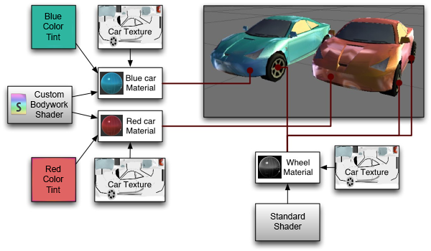

Slide 20
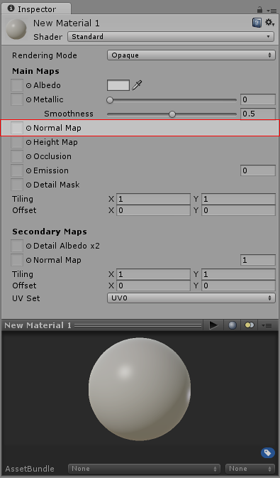
Normal map

Slide 21
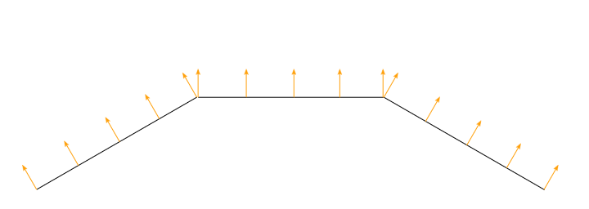
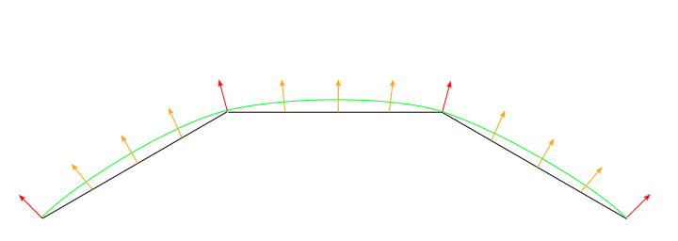
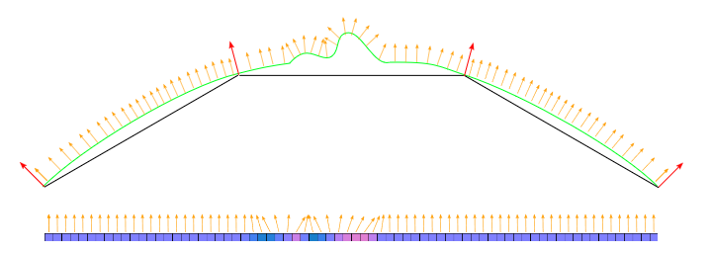

Slide 22
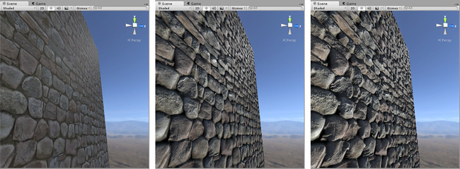
Normal Maps and Height Maps

Slide 23
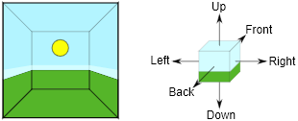
Reflection probes

Slide 24
The Reflection Probe component can be added to any object in the scene but you will typically want to add each probe to a separate empty GameObject. The usual workflow is:
Create a new empty GameObject (menu: GameObject > Create Empty) and then add the Reflection Probe component to it (menu: Component > Rendering > Reflection Probe). Alternatively, if you already have a probe in the scene you will probably find it easier to duplicate that instead (menu: Edit > Duplicate).
Place the new probe in the desired location and set its Origin point and the size of its zone of effect.
Optionally set other properties on the probe to customise its behaviour.
Continue adding probes until all required locations have been assigned

Slide 25
To see the reflections, you will also need at least one reflective object in the scene. A simple test object can be created as follows:
Add a primitive object such as a Sphere to the scene (menu: GameObject > 3D Object > Sphere).
Create a new material (menu: Assets > Create > Material) and leave the default Standard shader in place.
Make the material reflective by setting both the Metallic and Smoothness properties to 1.0.
Drag the newly-created material onto the sphere object to assign it.

Slide 26
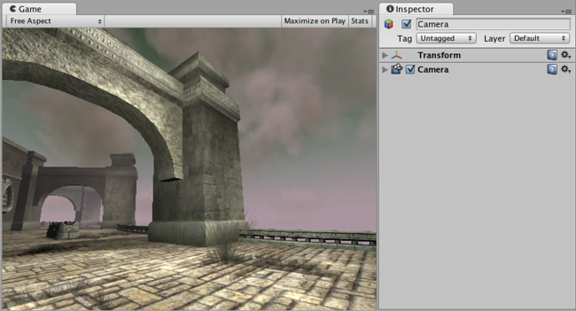
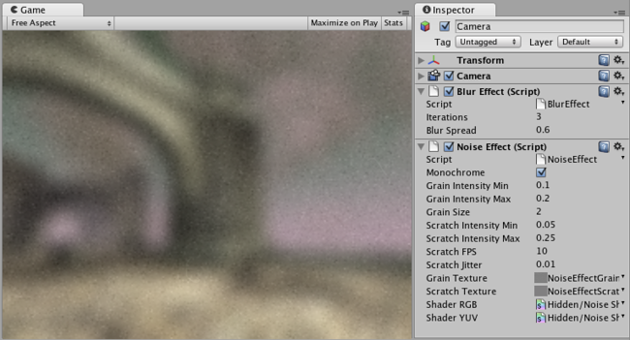
Image Effect

Slide 27
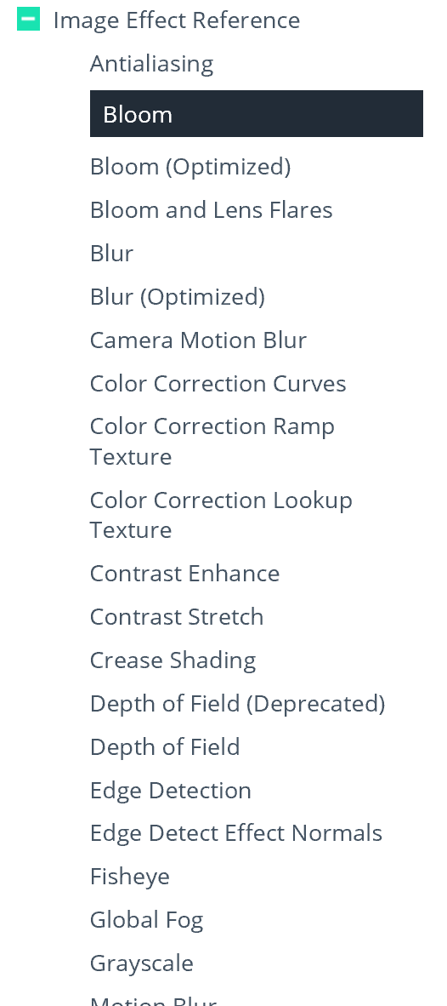

Slide 28
目录
光照、阴影及全局光照
摄像机及遮挡剔除优化
材质、着色器及环境映射
粒子系统
物理引擎
Mecanim动画系统
寻路
联网
创作中遇到的问题讨论

Slide 29
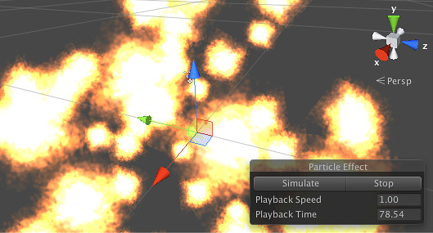

Slide 30
目录
光照、阴影及全局光照
摄像机及遮挡剔除优化
材质、着色器及环境映射
粒子系统
物理引擎
Mecanim动画系统
寻路
联网
创作中遇到的问题讨论

Slide 31
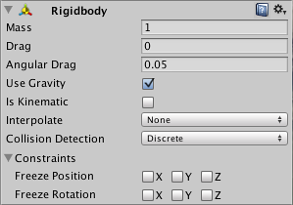
Rigidbody

Slide 32
Collider
The simplest colliders are the so-called primitive collider types
Box Collider, Sphere Collider and Capsule Collider
There are some cases, however, where even compound colliders are not accurate enough. In 3D, you can use Mesh Colliders to match the shape of the object’s mesh exactly

Slide 33
Joints
You can attach one rigidbody object to another or to a fixed point in space using a Joint component
Generally, you want a joint to allow at least some freedom of motion and so Unity provides different Joint components that enforce different restrictions

Slide 34
Character Controllers
The character in a first- or third-person game will often need some collision-based physics so that he doesn’t fall through the floor or walk through walls
Usually, though, the character’s acceleration and movement will not be physically realistic, so he may be able to accelerate, brake and change direction almost instantly without being affected by momentum.

Slide 35
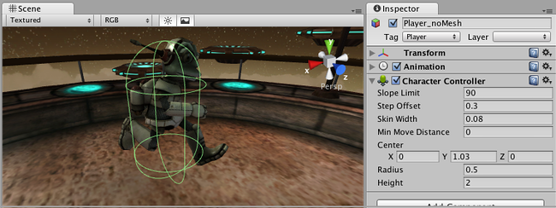

Slide 36
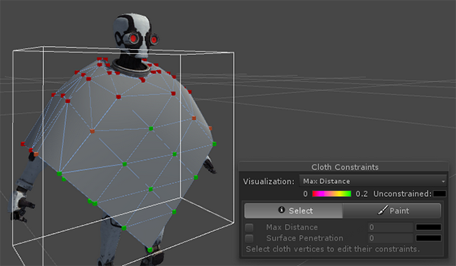
Cloth

Slide 37
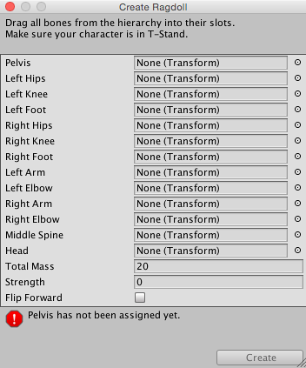
Ragdoll
Open the Ragdoll Wizard by choosing GameObject > 3D Object > Ragdoll… from the menu bar. You will now see the Wizard itself.

Slide 38
目录
光照、阴影及全局光照
摄像机及遮挡剔除优化
材质、着色器及环境映射
粒子系统
物理引擎
Mecanim动画系统
寻路
联网
创作中遇到的问题讨论

Slide 39
Easy workflow and setup of animations for all elements of Unity including objects, characters, and properties.
Support for imported animation clips and animation created within Unity
Humanoid animation retargeting - the ability to apply animations from one character model onto another.
Simplified workflow for aligning animation clips.
Convenient preview of animation clips, transitions and interactions between them. This allows animators to work more independently of programmers, prototype and preview their animations before gameplay code is hooked in.
Management of complex interactions between animations with a visual programming tool.
Animating different body parts with different logic.
Layering and masking features

Slide 40
Animation Clip
Smallest building blocks of animation in Unity
They represent an isolated piece of motion, such as RunLeft, Jump, or Crawl, and can be manipulated and combined in various ways to produce lively end results
Animation clips can be selected from imported FBX data (see FBXImporter settings for Animations)

Slide 41
Avatar
After a model file (FBX, COLLADA, etc.) is imported, you can specify what kind of rig it is in the Rig tab of the Model Importer options

Slide 42
Humanoid animations
For a Humanoid rig, select Humanoid and click Apply. Mecanim will attempt to match up your existing bone structure to the Avatar bone structure. In many cases, it can do this automatically by analysing the connections between bones in the rig.
If the match has succeeded, you will see a check mark next to the Configure menu

Slide 43
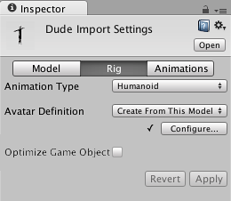

Slide 44
Non-humanoid animations
Two options for non-humanoid animation are provided: Generic and Legacy
Generic animations are imported using the Mecanim system but don’t take advantage of the extra features available for humanoid animations
Legacy animations use the animation system that was provided by Unity before Mecanim
There are some cases where it is still useful to work with legacy animations

Slide 45
Animation workflow
Each of these pieces - the Animation Clips, the Animator Controller, and the Avatar, are brought together on a GameObject via the Animator Component
This component has a reference to an Animator Controller, and (if required) the Avatar for this model. The Animator Controller, in turn, contains the references to the Animation Clips it uses.

Slide 46
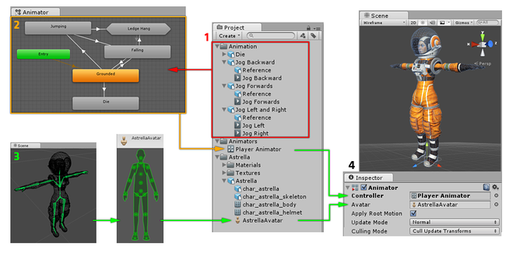

Slide 47
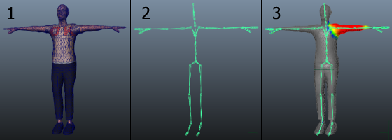

Slide 48
Animating objects and properties in Unity using Mecanim
You can create animation clips which animate any object or component property using Unity’s animation window
These animation clips can then be arranged into a state machine in exactly the same way as external animation clips such as character animations
For example, you could animate the motion of a camera, the colour of a light, the individual frames of a sprite animation, or a public property of a script.

Slide 49
Set up animation
Create a New Animator Controller
Open the Animator Window to edit the Animator Controller
Drag the desired animation clip into the Animator Controller Window
Drag the model asset into the Hierarchy.
Add the animator controller to the Animator component of the asset.

Slide 50
Masking Imported Clips
Masking allows you to discard some of the animation data within a clip, allowing the clip to animate only parts of the object or character rather than the entire thing
You could create a mask for the throwing animation limiting it to just the right arm, upper body and head
To apply a mask to an imported animation clip, first select the imported animation file in your project view, then in the import settings in the inspector, select the Animations button.

Slide 51
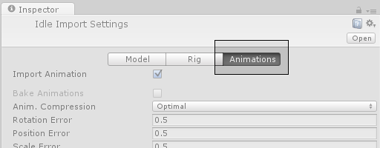
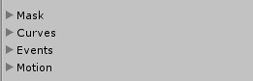
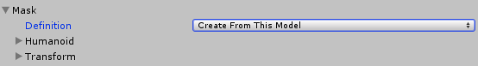
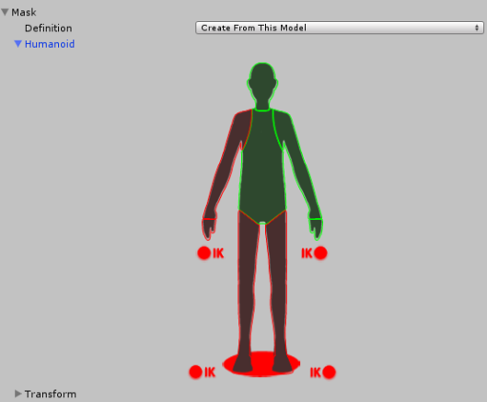
Then scroll all the way to the bottom of the inspector to find the Mask heading, among the four fold-out headings as shown:

Slide 52
Animation Curves on Imported Clips
Animation curves allow you to add additional animated data to an imported clip, which can allow you to animate the timings of other items based on the state of an animator
For example, in a game set in icy conditions, an extra animation curve could be used to control the emission rate of a particle system to show the player’s condensing breath in the cold air.

Slide 53
Expand the curves heading, and click the plus icon to add a new curve to the current animation clip
If your imported animation file is split into multiple animation clips, each clip can have its own custom curves.
The curve’s X-axis represents normalized time and always ranges between 0.0 and 1.0 (corresponding to the beginning and the end of the animation clip respectively, regardless of its duration).

Slide 54
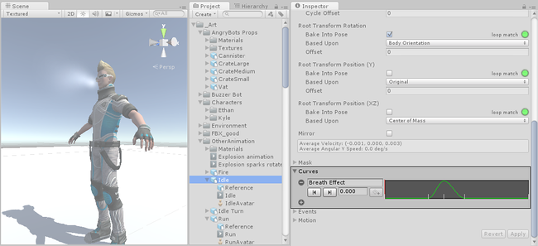
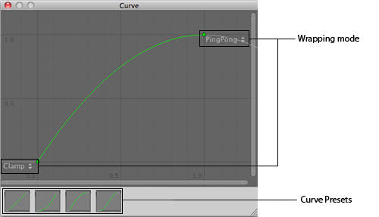

Slide 55
Animation Curves and Animator Controller parameters
If you have a curve with the same name as one of the parameters in the Animator Controller, then that parameter will take its value from the value of the curve at each point in the timeline
For example, if you make a call to GetFloat from a script, the returned value will be equal to the value of the curve at the time the call is made
Note that at any given point in time, there might be multiple animation clips attempting to set the same parameter from the same controller
In that case, the curve values from the multiple animation clips are blended
If an animation has no curve for a particular parameter then the blending will be done with the default value for that parameter.

Slide 56
Animation Events on Imported Clips
These events allow you to add additional data to an imported clip which determines when certain actions should occur in time with the animation
For example, for an animated character you might want to add events to walk and run cycles indicating when the footstep sounds should play

Slide 57
When adding an event, the event needs a name, which will be the name of the function that is called when the event is triggered
For any Gameobject which uses this animation in its animator, you should make sure the Gameobject has a corresponding script attached that contains a function whose name matches the event name
Below, you can see a footstep event set up to call the “Footstep” function in a script attached to the Player Gameobject.

Slide 58
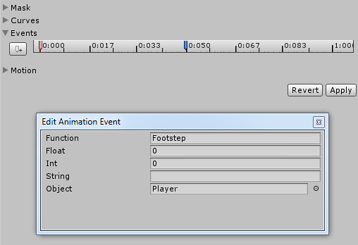

Slide 59
Animator Controllers

Slide 60
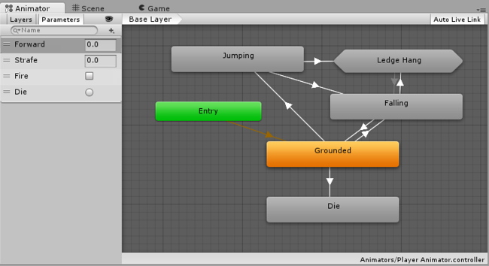

Slide 61
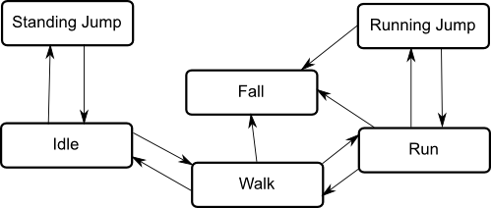
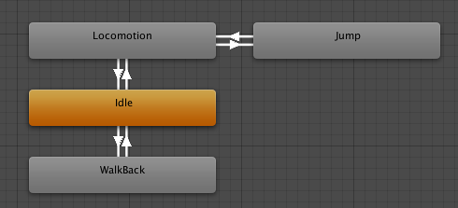
Animation State Machines

Slide 62
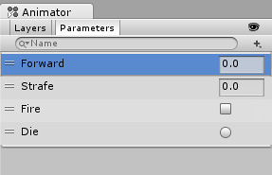
Animation Parameters
Animation Parameters are variables that are defined within an Animator Controller that can be accessed and assigned values from scripts
This is how a script can control or affect the flow of the state machine.
For example, a script can set a parameter to control a Blend Tree.

Slide 63
using UnityEngine;
using System.Collections;
public class SimplePlayer : MonoBehaviour {
Animator animator;
// Use this for initialization
void Start () {
animator = GetComponent<Animator>();
}
// Update is called once per frame
void Update () {
float h = Input.GetAxis("Horizontal");
float v = Input.GetAxis("Vertical");
bool fire = Input.GetButtonDown("Fire1");
animator.SetFloat("Forward",v);
animator.SetFloat("Strafe",h);
animator.SetBool("Fire", fire);
}
void OnCollisionEnter(Collision col) {
if (col.gameObject.CompareTag("Enemy"))
{
animator.SetTrigger("Die");
}
}
}

Slide 64
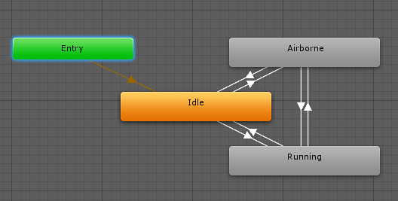
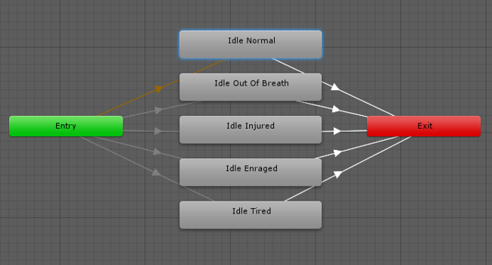
State Machine Transitions

Slide 65
State Machine Behaviours
A State Machine Behaviour is a special class of script
Can attach a StateMachineBehaviour script to an individual state within a state machine
This allows you to write code that will execute when the state machine enters, exits or remains within a particular state
This means you do not have to write your own logic to test for and detect changes in state.
A few examples for the use of this feature might be to:
Play sounds as states are entered or exited
Perform certain tests (eg, ground detection) only when in appropriate states
Activate and control special effects associated with specific states

Slide 66
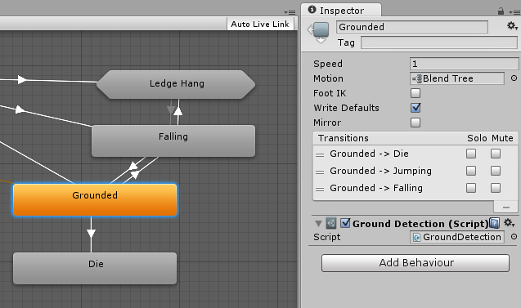

Slide 67
Sub-State Machines
It is common for a character to have complex actions that consist of a number of stages
Rather than handle the entire action with a single state, it makes sense to identify the separate stages and use a separate state for each
For example, a character may have an action called “Trickshot” where it crouches to take a steady aim, shoots and then stands up again.

Slide 68
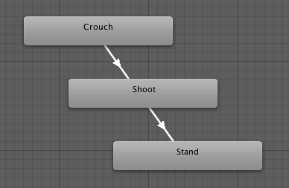
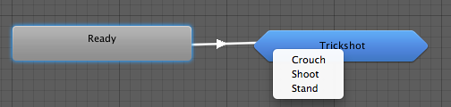

Slide 69
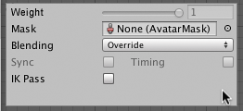
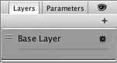
Animation Layers
Unity uses Animation Layers for managing complex state machines for different body parts
walking-jumping, and an upper-body layer for throwing objects / shooting

Slide 70
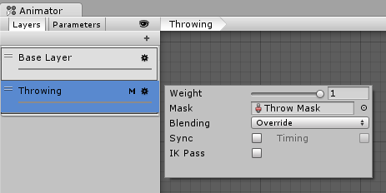
On each layer, you can specify the mask (the part of the animated model on which the animation would be applied), and the Blending type
Override means information from other layers will be ignored
Additive means that the animation will be added on top of previous layers.
The Mask property is there to specify the mask used on this layer
If you wanted to play a throwing animation on just the upper body of your model, while having your character also able to walk, run or stand still at the same time, you would use a mask on the layer which plays the throwing animation where the upper body sections are defined

Slide 71
Animation Layer syncing
Sometimes it is useful to be able to re-use the same state machine in different layers
If you want to simulate “wounded” behavior, and have “wounded” animations for walk / run / jump instead of the “healthy” ones. You can click the Sync checkbox on one of your layers, and then select the layer you want to sync with. The state machine structure will then be the same, but the actual animation clips used by the states will be distinct.
This means the Synced layer does not have its own state machine definition at all - instead, it is an instance of the source of the synced layer. Any changes you make to the layout or structure of the state machine in the synced layer view (eg, adding/deleting states or transitions) is done to the source of the synced layer
The only changes that are unique to the synced layer are the selected animations used within each state.

Slide 72
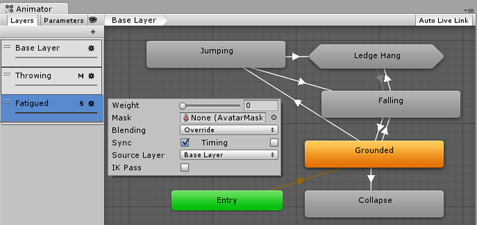

Slide 73
Solo and Mute functionality
In complex state machines, it is useful to preview the operation of some parts of the machine separately
For this, you can use the Mute / Solo functionality
Muting means a transition will be disabled. Soloed transtions are enabled and with respect to other transitions originating from the same state
You can set up mute and solo states either from the Transition Inspector, or the State Inspector (recommended), where you’ll have an overview of all the transitions from that state.

Slide 74


In the example above, if you are in State 0, only transitions to State A and State B will be available.
The basic rule of thumb is that if one Solo is ticked, the rest of the transitions from that state will be muted.
If both Solo and Mute are ticked, then Mute takes precedence.

Slide 75
Target Matching
Often in games, a situation arises where a character must move in such a way that a hand or foot lands at a certain place at a certain time
For example, the character may need to jump across stepping stones or jump and grab an overhead beam.
You can use the Animator.MatchTarget function to handle this kind of situation

Slide 76

For example, you want to arrange an situation where the character jumps onto a platform and you already have an animation clip for it called Jump Up
Firstly, you need to find the place in the animation clip at which the character is beginning to get off the ground, note in this case it is 14.1% or 0.141 into the animation clip in normalized time

Slide 77

You also need to find the place in the animation clip where the character is about to land on his feet, which in this case is at 78.0% or 0.78.

Slide 78
using UnityEngine;
using System;
[RequireComponent(typeof(Animator))]
public class TargetCtrl : MonoBehaviour {
protected Animator animator;
//the platform object in the scene
public Transform jumpTarget = null;
void Start () {
animator = GetComponent<Animator>();
}
void Update () {
if(animator) {
if(Input.GetButton("Fire1"))
animator.MatchTarget(jumpTarget.position, jumpTarget.rotation, AvatarTarget.LeftFoot,
new MatchTargetWeightMask(Vector3.one, 1f), 0.141f, 0.78f);
}
}
}

Slide 79
Inverse Kinematics
Most animation is produced by rotating the angles of joints in a skeleton to predetermined values. The position of a child joint changes according to the rotation of its parent and so the end point of a chain of joints can be determined from the angles and relative positions of the individual joints it contains. This method of posing a skeleton is known as forward kinematics.
However, it is often useful to look at the task of posing joints from the opposite point of view - given a chosen position in space, work backwards and find a valid way of orienting the joints so that the end point lands at that position. This can be useful when you want a character to touch an object at a point selected by the user or plant its feet convincingly on an uneven surface. This approach is known as Inverse Kinematics (IK) and is supported in Mecanim for any humanoid character with a correctly configured Avatar

Slide 80
To set up IK for a character, you typically have objects around the scene that a character interacts with, and then set up the IK thru script, in particular, Animator functions like SetIKPositionWeight, SetIKRotationWeight, SetIKPosition, SetIKRotation, SetLookAtPosition, bodyPosition, bodyRotation

Slide 81


Slide 82


Slide 83
using UnityEngine;
using System;
using System.Collections;
[RequireComponent(typeof(Animator))]
public class IKControl : MonoBehaviour {
protected Animator animator;
public bool ikActive = false;
public Transform rightHandObj = null;
public Transform lookObj = null;
void Start ()
{
animator = GetComponent<Animator>();
}
//a callback for calculating IK
void OnAnimatorIK()
{
if(animator) {
//if the IK is active, set the position and rotation directly to the goal.
if(ikActive) {
// Set the look target position, if one has been assigned
if(lookObj != null) {
animator.SetLookAtWeight(1);
animator.SetLookAtPosition(lookObj.position);
}
// Set the right hand target position and rotation, if one has been assigned
if(rightHandObj != null) {
animator.SetIKPositionWeight(AvatarIKGoal.RightHand,1);
animator.SetIKRotationWeight(AvatarIKGoal.RightHand,1);
animator.SetIKPosition(AvatarIKGoal.RightHand,rightHandObj.position);
animator.SetIKRotation(AvatarIKGoal.RightHand,rightHandObj.rotation);
}
}
//if the IK is not active, set the position and rotation of the hand and head back to the original position
else {
animator.SetIKPositionWeight(AvatarIKGoal.RightHand,0);
animator.SetIKRotationWeight(AvatarIKGoal.RightHand,0);
animator.SetLookAtWeight(0);
}
}
}
}

Slide 84



Slide 85

Scripting Root Motion for “in-place” humanoid animations
The animation does not contain “root motion”. For this, we can modify root motion from script
On the animation clip create a curve that will control the speed of the character (you can add a curve from the Animation Import inspector Curves-> +)
Name that curve something meaningful, like “Runspeed”

Slide 86

Create a new Animator Controller
Drop the desired animation clip into it
Add a parameter to the Controller with the same name as the curve (Runspeed)

Slide 87
Select the character Dude in the Hierarchy, whose inspector should already have an Animator component.
Drag RootMotionController onto the Controller property of the Animator
If you press play now, you should see the “Dude” running in place

Slide 88
using UnityEngine;
using System.Collections;
[RequireComponent(typeof(Animator))]
public class RootMotionScript : MonoBehaviour {
void OnAnimatorMove()
{
Animator animator = GetComponent<Animator>();
if (animator)
{
Vector3 newPosition = transform.position;
newPosition.z += animator.GetFloat("Runspeed") * Time.deltaTime;
transform.position = newPosition;
}
}
}

Slide 89

Animator component will detect that the script has an OnAnimatorMove function and show the Apply Root Motion property as Handled by Script

Slide 90
Blend Trees
Perhaps the best known example is the blending of walking and running animations according to the character’s speed. Another example is a character leaning to the left or right as he turns during a run.
Transitions VS Blend Trees
While both are used for creating smooth animation, they are used for different kinds of situations.
Transitions are used for transitioning smoothly from one Animation State to another over a given amount of time. Transitions are specified as part of an Animation State Machine. A transition from one motion to a completely different motion is usually fine if the transition is quick.
Blend Trees are used for allowing multiple animations to be blended smoothly by incorporating parts of them all to varying degrees. The amount that each of the motions contributes to the final effect is controlled using a blending parameter, which is just one of the numeric animation parameters associated with the Animator Controller. In order for the blended motion to make sense, the motions that are blended must be of similar nature and timing. Blend Trees are a special type of state in an Animation State Machine.

Slide 91
Examples of similar motions could be various walk and run animations. In order for the blend to work well, the movements in the clips must take place at the same points in normalized time. For example, walking and running animations can be aligned so that the moments of contact of foot to the floor take place at the same points in normalized time (e.g. the left foot hits at 0.0 and the right foot at 0.5). Since normalized time is used, it doesn’t matter if the clips are of different length.

Slide 92
Using Blend Trees
Right-click on empty space on the Animator Controller Window.
Select Create State > From New Blend Tree from the context menu that appears.
Double-click on the Blend Tree to enter the Blend Tree Graph.
The Animator Window now shows a graph of the entire Blend Tree while the Inspector shows the currently selected node and its immediate children.

Slide 93



Slide 94
Performance and Optimization

Slide 95
Number of Bones
In some cases you will need to create characters with a large number of bones, for example when you want a lot of customizable attachments
These extra bones will increase the size of the build, and you could expect to have a relative processing cost for each additional bone
For example, 15 additional bones on a rig that already has 30 bones will take 50% longer to solve in Generic mode
When you have no animations playing using the additional bones, the processing cost should be negligible. This cost will be even lower if their attachments are non existent or hidden.

Slide 96
Multiple Skinned Meshes
Combine skinned meshes whenever possible
Splitting a character into two Skinned Mesh Renderers is a bad idea with regard to performance
It’s better if your character has just one material, but there are some cases when you might require more materials.

Slide 97
Controllers
The Animator doesn’t spend time processing when a Controller is not set to it.

Slide 98
Simple Animation
Playing a single Animation Clip with no blending can make Mecanim slower than the legacy animation system.
The Mecanim layout is optimized for animation blending and more complex setups.

Slide 99
Scale Curves
Animating scale curves is more expensive than animating translation and rotation curves. To improve performance, avoid scale animations.
Note: This does not apply to constant curves (curves that have the same value for the length of the Animation Clip ). Constant curves are optimized, and are less expensive that normal curves.

Slide 100
Layers
Most of the time Mecanim is evaluating animations, and the overhead for AnimationLayers and AnimationStateMachines is kept to the minimum
The cost of adding another layer to the animator, synchronized or not, depends on what animations and blend trees are played by the layer
When the weight of the layer is zero, the layer update will be skipped.

Slide 101
Humanoid vs. Generic Modes
When importing Humanoid animation use a BodyMask to remove IK Goals or fingers animation if they are not needed.
When you use Generic, using root motion is more expensive than not using it
If your animations don’t use root motion, make sure that you have no root bone selected.

Slide 102
Mecanim Scene
Use hashes instead of strings to query the Animator.
Implement a small AI Layer to control the Animator
You can make it provide simple callbacks for OnStateChange, OnTransitionBegin, etc.
Use State Tags to easily match your AI state machine to the Mecanim state machine.
Use additional curves to simulate Events.
Use additional curves to mark up your animations, for example in conjunction with target matching.

Slide 103
Runtime Optimizations
Always optimize animations by setting the animators’s Culling Mode to Based on Renderers, and disable the skinned mesh renderer’s Update When Offscreen property
This way animations won’t be updated when the character is not visible

Slide 104
目录
光照、阴影及全局光照
摄像机及遮挡剔除优化
材质、着色器及环境映射
粒子系统
物理引擎
Mecanim动画系统
寻路
联网
创作中遇到的问题讨论

Slide 105


Slide 106
NavMesh (short for Navigation Mesh) is a data structure which describes the walkable surfaces of the game world and allows to find path from one walkable location to another in the game world. The data structure is built, or baked, automatically from your level geometry.
NavMesh Agent component help you to create characters which avoid each other while moving towards their goal. Agents reason about the game world using the NavMesh and they know how to avoid each other as well as moving obstacles.
Off-Mesh Link component allows you to incorporate navigation shortcuts which cannot be represented using a walkable surface. For example, jumping over a ditch or a fence, or opening a door before walking through it, can be all described as Off-mesh links.
NavMesh Obstacle component allows you to describe moving obstacles the agents should avoid while navigating the world. A barrel or a crate controlled by the physics system is a good example of an obstacle. While the obstacle is moving the agents do their best to avoid it, but once the obstacle becomes stationary it will carve a hole in the navmesh so that the agents can change their paths to steer around it, or if the stationary obstacle is blocking the path way, the agents can find a different route.

Slide 107

Walkable Areas

Slide 108

Finding Paths

Slide 109

Following the Path

Slide 110

Avoiding Obstacles

Slide 111

Describing Off-mesh Links

Slide 112
Building a NavMesh
Select scene geometry that should affect the navigation – walkable surfaces and obstacles.
Check Navigation Static on to include selected objects in the NavMesh baking process.
Adjust the bake settings to match your agent size.
Agent Radius defines how close the agent center can get to a wall or a ledge.
Agent Height defines how low the spaces are that the agent can reach.
Max Slope defines how steep the ramps are that the agent walk up.
Step Height defines how high obstructions are that the agent can step on.
Click bake to build the NavMesh.

Slide 113



Slide 114

Creating a NavMesh Agent

Slide 115
// MoveTo.cs
using UnityEngine;
using System.Collections;
public class MoveTo : MonoBehaviour {
public Transform goal;
void Start () {
NavMeshAgent agent = GetComponent<NavMeshAgent>();
agent.destination = goal.position;
}
}

Slide 116

Creating an Off-mesh Link

Slide 117

Building Height Mesh for Accurate Character Placement
Notes:
While navigating, the NavMesh Agent is constrained on the surface of the NavMesh. Since the NavMesh is an approximation of the walkable space, some features are evened out when the NavMesh is being built. For example, stairs may appear as a slope in the NavMesh. If your game requires accurate placement of the agent, you should enable Height Mesh building when you bake the NavMesh. The setting can be found under the Advanced settings in Navigation window. Note that building Height Mesh will take up memory and processing at runtime, and it will take a little longer to bake the NavMesh.

Slide 118

Navigation Areas and Costs

Slide 119


Slide 120

Area Types

Slide 121

Area Mask
Each agent has an Area Mask which describes which areas it can use when navigating. The area mask can be set in the agent properties, or the bitmask can be manipulated using a script at runtime.

Slide 122


Loading Multiple NavMeshes using Additive Loading
Notes:
The NavMeshes in different Scenes are not connect by default. When you load another level using Application.LoadLevelAdditive() you will need to connect the NavMeshes in different Scenes using an Off-Mesh link.
In this example we have Scene 1 and Scene 2. The Scene 1 has an Off-Mesh Link starting over a walkable area and landing over a walkable area in Scene 2. There can be as many Off-Mesh Links connecting the Scenes as necessary.
When authored the other end point of the scene connecting Off-Mesh links are not connected. After a new Scene is loaded, the Off-Mesh Links will be reconnected.
If the multiple scenes have NavMesh overlapping at the same area, the position picking may be arbitrary NavMesh at that location. This applies to agents, Off-Mesh Links and position picking using the NavMesh API. You should create the scene crossing Off-Mesh links so that they start and end clearly on over one NavMesh only. Overlapping NavMesh areas are not automatically connected.

Slide 123
Using NavMesh Agent with Other Components

Slide 124
NavMesh Agent and Physics
You don’t need to add physics colliders to NavMesh Agents for them to avoid each other
That is, the navigation system simulates agents and their reaction to obstacles and the static world. Here the static world is the baked NavMesh.
If you want a NavMesh Agent to push around physics objects or use physics triggers:
Add a Collider component (if not present)
Add Rigidbody component
Turn on kinematic (Is Kinematic) - this is important!
Kinematic means that the rigid body is controlled by something else than the physics simulation
If both NavMesh Agent and Rigidbody (non-kinematic) are active at the same time, you have race condition
Both components may try to move the agent at the same which leads to undefined behavior
You can use a NavMesh Agent to move e.g. a player character, without physics
Set players agent’s avoidance priority to a small number (high priority), to allow the player to brush through crowds
Move the player agent using NavMeshAgent.velocity, so that other agents can predict the player movement to avoid the player.

Slide 125
NavMesh Agent and Animator
NavMesh Agent and Animator with Root Motion can cause race condition
Both components try to move the transform each frame
Two possible solutions
Information should always flow in one direction
Either agent moves the character and animations follows
Or animation moves the character based on simulated result
Otherwise you’ll end up having a hard to debug feedback loop
Animation follows agent
Use the NavMeshAgent.velocity as input to the Animator to roughly match the agent’s movement to the animations
Robust and simple to implement, will result in foot sliding where animations cannot match the velocity
Agent follows animation
Disable NavMeshAgent.updatePosition and NavMeshAgent.updateRotation to detach the simulation from the game objects locations
Use the difference between the simulated agent’s position (NavMeshAgent.nextPosition) and animation root (Animator.rootPosition) to calculate controls for the animations
See Coupling Animation and Navigation for more details

Slide 126
NavMesh Agent and NavMesh Obstacle
Do not mix well!
Enabling both will make the agent trying to avoid itself
If carving is enabled in addition, the agent tries to constantly remap to the edge of the carved hole, even more erroneous behavior ensues
Make sure only one of them are active at any given time
Deceased state, you may turn off the agent and turn on the obstacle to force other agents to avoid it
Alternatively you can use priorities to make certain agents to be avoided more

Slide 127
NavMesh Obstacle and Physics
If you want physics controlled object to affect NavMesh Agent’s behavior
Add NavMesh Obstacle component to the object which agent should be aware of, this allows the avoidance system to reason about the obstacle
If a game object has a Rigidbody and a NavMesh Obstacle attached, the obstacle’s velocity is obtained from the Rigidbody automatically
This allows NavMesh Agents to predict and avoid the moving obstacle

Slide 128
目录
光照、阴影及全局光照
摄像机及遮挡剔除优化
材质、着色器及环境映射
粒子系统
物理引擎
Mecanim动画系统
寻路
联网
创作中遇到的问题讨论

Slide 129
Intro
Unity 5.1 has a new and improved Networking system with more flexibility and power than the networking system provided in earlier versions of Unity
It has a lower level NetworkTransport class which is a thin layer above basic sockets and then higher level components which add more useful multiplayer features.

Slide 130
Networking overview
There are two kinds of users for the Networking feature:
Users making a Multiplayer game with Unity. These users should start with the NetworkManager or the High Level API.
Users building network infrastructure or advanced multiplayer games. These users should start with the NetworkTransport API.

Slide 131


Slide 132

Server and Host
In the unity networking system, games have a Server and multiple Clients
When there is no dedicated server, one of the clients plays the role of the server - we call this client the “host”.

Slide 133



Slide 134
Getting Started with NetworkManager
The NetworkManager can be used as the core controlling component of a multiplayer game
Create an empty game object in your starting scene, or pick a convenient manager object
Then add the NetworkManager component from the Network/NetworkManager menu item

Slide 135


Slide 136

The inspector for the NetworkManager in the editor allows you to configure and control many things related to networking.
The NetworkManagerHUD is another component that works with the NetworkManager
This is good for getting started with a network project, but not intended to be used as the final UI for a game

Slide 137
Game State Management
A UNet multiplayer game can run in three modes - as a client, as a dedicated server, or as a “Host” which is both a client and a server at the same time
UNet is designed to make the same game code and assets work in all of these cases
Developing for the single player version of the game and the multiplayer version of the game should be the same thing

Slide 138


Slide 139
Spawning Management
The NetworkManager can be used to manage spawning of networked objects from prefabs
When a player prefab is set, a player object will automatically be spawned from that prefab for each user in the game. This applies to the local player on a hosted server, and remote players on remote clients. Note that the player prefab must have the NetworkIdentity component on it.
In addition to the player prefab, the prefabs of other objects that will be dynamically spawned must be registered with the ClientScene
Adding prefabs to the spawn list will make them be auto-registered.
This can be done with the ClientScene.RegisterPrefab() functions
or it can be done by the NetworkManager automatically.

Slide 140


Slide 141
Matchmaking
The NetworkManager runtime UI and NetworkManager inspector UI allow interactions with the matchmaker service
The function NetworkManager.StartMatchmaker() enables matchmaking, and populates the NetworkManager.matchmaker property with a NetworkMatch object
Once this is active, the default UIs use it and callback functions on NetworkManager to let you perform simple matchmaking

Slide 142


Slide 143


Slide 144
Basic Player Game State
Make scripts that contain important data into NetworkBehaviours instead of MonoBehaviours
Make important member variables into SyncVars
Notes:
See State Synchronization.

Slide 145
Networked Actions
Make scripts that perform important actions into NetworkBehaviours instead of MonoBehaviours
Update functions that perform important player actions to be Commands
Notes:
See Networked Actions.

Slide 146
Non-Player Objects
Fix non-player prefabs such as enemies:
Add NetworkIdentify component
Add NetworkTransform component
Register spawnable prefabs with NetworkManager
Update scripts with game state and actions

Slide 147
Spawners
Potentially change spawner scripts to be NetworkBehaviours
Modify spawners to only run on the server, use isServer property or OnStartServer() function
Call NetworkServer.Spawn() for created objects
Select the NetworkManager object and in the Spawn Info section under the Registered Spawnable Prefabs, press the + icon and assign the bullet prefab to the empty space. Now, you can remove the Bullet object from the scene

Slide 148
Spawn Positions for players
Add new game object and place at player start location
Add NetworkStartPosition component to new game object

Slide 149
改造一个游戏为多人联网
Create a new scene and save it
Create a new game object, name it NetworkManager
Add two components to it: NetworkManager and NetworkManagerHUD
Create a new game object called Player. This will be our player to be spawned when connected to the server.
Add a NetworkIdentity component to this object. Check "Local Player Authority".
Add a NetworkTransform component as well. This will handle the transform syncing automatically.
After adding the newly created Player component to the Player object, create a prefab from this object (drag & drop from the Hiearchy to the Assets tab)
Select the NetworkManager, expand "Spawn Info" section, and assign the previously created prefab to the Player Prefab

Slide 150
实时生成物体
Create a new game object, call it Bullet
Add a NetworkIdentity and a NetworkTransform components to it - note the Local Player Authority is not checked this time!
Select the NetworkManager object and in the Spawn Info section under the Registered Spawnable Prefabs, press the + icon and assign the bullet prefab to the empty space. Now, you can remove the Bullet object from the scene
This registering means that your clients will be able to spawn this object. This is a must-have step.
The client cannot spawn networked object itself, it can just ask the server to spawn a new one. To have shooting, we have to modify our Player class

Slide 151
目录
光照、阴影及全局光照
摄像机及遮挡剔除优化
材质、着色器及环境映射
粒子系统
物理引擎
Mecanim动画系统
寻路
联网
创作中遇到的问题讨论

